Slide 1
EE5907/EE5027 Week 5: Non-Parametric Techniques
BT Thomas Yeo
ECE, CIRC, Sinapse, Duke-NUS, HMS

Slide 2
Last Week Recap
Discriminative Classifier p(y | x, w): Logistic Regression
Notes:
Last week, I introduced to you the first discriminative classifier: logistic regression.

Slide 3
Last Week Recap
Discriminative Classifier p(y | x, w): Logistic Regression
Numerical optimization
Gradient descent
Notes:
The cost function negative log likelihood cannot be optimized in close form, so I took the chance to introduce certain numerical optimization approaches, including gradient descent

Slide 4
Last Week Recap
Discriminative Classifier p(y | x, w): Logistic Regression
Numerical optimization
Gradient descent
Newton’s method
Notes:
And Newton’s method

Slide 5
Last Week Recap
Discriminative Classifier p(y | x, w): Logistic Regression
Numerical optimization
Gradient descent
Newton’s method
Hessian positive definite everywhere => cost function convex => unique global minimum and every local minimum is global minimum
Notes:
I also explained that if the Hessian is positive definite everywhere, this would imply the cost function is convex, which implies that it has a unique global minimum and every local minimum is a global minimum.

Slide 6
Last Week Recap
Discriminative Classifier p(y | x, w): Logistic Regression
Numerical optimization
Gradient descent
Newton’s method
Hessian positive definite everywhere => cost function convex => unique global minimum and every local minimum is global minimum
Logistic regression
NLL is convex – optimize with Newton’s method
Notes:
In the case of logistic regression, the cost function Negative Log Likelihood is convex, so we can optimize with Newton’s method

Slide 7
Last Week Recap
Discriminative Classifier p(y | x, w): Logistic Regression
Numerical optimization
Gradient descent
Newton’s method
Hessian positive definite everywhere => cost function convex => unique global minimum and every local minimum is global minimum
Logistic regression
NLL is convex – optimize with Newton’s method
Bias term
Regularization
Notes:
However, we first have to include a bias term and l2 regularization.

Slide 8
This week
Non-parametric approaches
Parzen’s Window
K-nearest neighbors
Notes:
So far, all the approaches we discuss, assumes probability distributions with specific shape or form. For example, Gaussian or beta distributions.
Today, we will talk about non-parametric approaches, which we do assume that our data follow specific distributions, such as Gaussians.
There are two approaches I will talk about. Parzen’s window and K nearest neighbors.

Slide 9
Motivation
Notes:
Let’s consider two problems.
The first problem is density estimation. Given data samples x1, x2 to xN, for example the blue circles here, we want to estimate the distribution p of x.

Slide 10
Motivation
Notes:
Suppose we assume p(x) is Gaussian with variance 1, then from previous classes, the maximum likelihood estimate of the Gaussian mean is the empirical mean of the samples.
And so one estimate of p of x is a Gaussian distribution with mean equal to the empirical mean and a variance of 1.

Slide 11
Motivation
Notes:
However, what if we do not know what kind of distribution p is?
For example, suppose we observe the red circles, this is clearly not a Gaussian. So how do we estimate p of x?

Slide 12
Motivation
Notes:
In this case, the underlying distribution actually looks like this, which is a mixture of two gaussian distributions.

Slide 13
Motivation
Notes:
In the second problem, we want to look at classification.
Recall that in classification, we are given the training data D consisting of the input-output pairs xn and yn. And we are supposed to learn the mapping y is equal to f of x.
What if we do not know what kind of function f is?

Slide 14
Motivation
Notes:
In the first problem, we do not know what kind of distribution p is.
In the second problem, we do not know what kind of function f is.
We can get around this issue using non-parametric approaches.

Slide 15
Non-parametric Density Estimation: Parzen Window
Notes:
We will now move on to non-parametric density estimation techniques.

Slide 16
Overview
Notes:
In all our previous lectures, we have worked with probability distributions parameterized by a few parameters, such as Gaussians, beta distributions and so on.
To estimate these distributions, we just need to estimate the parameters of the distribution. For example, for univariate Gaussians, we just need to estimate the mean and variance and we will have complete information about the distribution.
In contrast, we now consider non-parametric estimation of probability distributions.

Slide 17
Overview
Notes:
Now, non-parametric does not mean no parameter!

Slide 18
Overview
Notes:
But rather, the number and nature of parameters change with data.
Typically, the number of parameters grows as we get more data.

Slide 19
Overview
Notes:
Non-parametric approaches usually make less assumptions, but the downside is that more data are needed for them to work well.
For example, the Gaussian distribution can only have one peak (at the mean), if we have a bi-modal distribution with two peaks, then Gaussians wouldn’t work very well.
In this case, non-parametric approaches can more easily model distributions with multiple humps.

Slide 20
Overview
Notes:
The idea is very simple.
Suppose we have N i.i.d samples from an unknown distribution p of x.
Let’s call the samples x1, x2, to xN

Slide 21
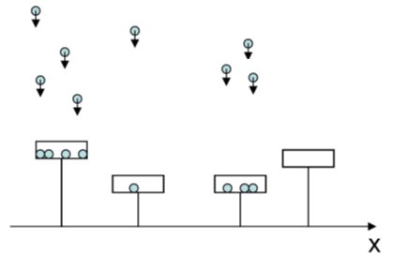
Overview
More samples in window => larger p(x)
Notes:
For a particular x, we can consider a window of volume V centered at x, and count the number of samples k that fall inside this window
This is illustrated by this one dimensional distribution. At this location, we consider this window, and 4 of 8 samples fall into this interval V. At this location one of 8 samples fall into this window. At this location, 3 of the 8 samples fall into the window. At this location, 0 sample fall into the window.

Slide 22
Overview
More samples in window => larger p(x)
Notes:
We can then approximate the probability distribution function at location x as the number of samples k that falls into the window divided by the total number of samples N divided by the window volume V.
Does this make intuitive sense? K over N is the fraction of samples that fall inside the window. If the fraction is very high, then the pdf is larger. If the window volume V is very big, then obviously we would capture more samples, and so the estimated pdf should be smaller.
We will make this more rigorous later, but right now one obvious question is how to select the window size V.

Slide 23
Overview
More samples in window => larger p(x)
Notes:
There are two approaches.
The first approach is called Parzen Window. In this approach, we fix the window volume V and count the number of samples k that fall inside the window.

Slide 24
Overview
More samples in window => larger p(x)
Notes:
The second approach is called K nearest neighbor. In this case, we fix k, and we grow the window size V until the window captures K neighbors.
I will now go through each approach in more details.

Slide 25
Parzen Window
j indexes dimensionality of data
Notes:
Let’s first consider a square cube. Phi(u) is equal to 1 for absolute value of uj less than or equal to 0.5, for j = 1 to d, where d corresponds to the d-dimensional space.
Phi of u is illustrated here for 2 dimensions. So phi(u) is 1 inside the red square and 0 outside the red square.

Slide 26
Parzen Window
j indexes dimensionality of data
Notes:
Phi of u divided by h is equal to 1 inside the hypercube of width h, again illustrated here for two dimensions.
Therefore phi of u over h is equal to 1 inside this red square of width h and 0 outside this square.

Slide 27
Parzen Window
j indexes dimensionality of data
x_{i} = i-th data point
x_{i} = vector of length d
Notes:
Now phi of x MINUS xi divided by h is going to be 1 if xi is inside a hypercube of width h centered at x and is equal to 0 otherwise.

Slide 28
Parzen Window
j indexes dimensionality of data
x_{i} = i-th data point
x_{i} = vector of length d
Notes:
Let k of x be equal to sum over all sample points i phi of x – xi divided by h.
Since phi of x – xi divided by h is equal to one if sample xi is inside hypercube centered at x.
Then summing over i gives the number of samples inside hypercube of width h centered at x.

Slide 29
Parzen Window
j indexes dimensionality of data
x_{i} = i-th data point
x_{i} = vector of length d
Notes:
In this case, the parzen window estimate of the probability density p at location x is k of x DIVIDED by the total number of samples N and the volume of the hypercube V.

Slide 30
Parzen Window
j indexes dimensionality of data
x_{i} = i-th data point
x_{i} = vector of length d
Notes:
The volume of the hypercube is simply h to the power of d.
And we plug in the number of samples k of x to be sum over i phi of x – xi divided by h.

Slide 31
Parzen Window
j indexes dimensionality of data
x_{i} = i-th data point
x_{i} = vector of length d
Notes:
Which we can re-arrange to be the following expression: 1 over N sum from i = 1 to N 1 over h to the power of d phi of x – xi divided by h.
Let’s try to interpret this expression in two different ways.

Slide 32
Parzen Window as Histogramming
Notes:
This equation up here is what we have just seen in the previous slide.
The first interpretation of this equation is that at a location x, we count the fraction of samples in hypercube centered at x and then divide this fraction by the volume 1 over h to the power of d.

Slide 33
Parzen Window as Histogramming
1 2 3 4 5 6 7 8 9 10 11
Notes:
For example, let’s consider 6 samples which happens to fall onto locations 2, 3, 4, 8, 10 and 11.

Slide 34
Parzen Window as Histogramming
1 2 3 4 5 6 7 8 9 10 11
Notes:
Let compute the parzen’s window estimate at location x equal to 1.
In this case, it’s a one dimensional space, so d is equal to 1.
Let’s consider window of width h = 3 indicated by this green rectangle here.

Slide 35
Parzen Window as Histogramming
1 2 3 4 5 6 7 8 9 10 11
Notes:
So let’s plug all this information into the formula. So p of 1 is equal to 1 over 6 because there are 6 samples, sum from i = 1 to 6,
1 over 3, because the volume of the interval is 3 to the power of 1.
Phi of x = 1 – xi divided by h = 3.

Slide 36
Parzen Window as Histogramming
1 2 3 4 5 6 7 8 9 10 11
Notes:
We see that only the sample at location 2 is inside the green window, so all the terms in the summation are 0 except for the term corresponding to the sample at location 2.
So we get p of 1 equal to 1 over 18.

Slide 37
Parzen Window as Interpolation
1 2 3 4 5 6 7 8 9 10 11
Notes:
A second interpretation of the Parzen’s window estimate is that p of x is equal to the sum of N hypercubes, where each hypercube is centered at training sample xi.
So we add a window centered at 2. The window is of width 3 and height 1 over 18.
And we add a window centered at 3, window centered at 4, window centered at 8, window centered at 10 and window centered at 11.
And then we add all the windows resulting in this blue curve, which is the parzen window estimate of p of x.

Slide 38
Parzen Window as Interpolation
1 2 3 4 5 6 7 8 9 10 11
Notes:
The above interpretation suggests that instead of adding hypercube centered at each data point, we can use other windows like Gaussian.
Typically, we would choose the window to be positive everywhere and the volume of the window is equal to 1.
We see that the hypercube definitely satisfy these two conditions.

Slide 39
Parzen Window as Interpolation
1 2 3 4 5 6 7 8 9 10 11
Notes:
The first condition ensures that the parzen window estimate of p is greater than or equal to 0 everywhere because if the window phi of u is at least 0 everywhere, then a linear combination of phi of u is going to be greater than or equal to 0 everywhere.

Slide 40
Parzen Window as Interpolation
1 2 3 4 5 6 7 8 9 10 11
Notes:
In addition, the parzen window estimate is also going to integrate to one.
Because 1 over h to the power of d, phi of x – xi divided by h, integral over dx is equal to 1. We can show this quite easily by performing a change of variable substitution. Let u = x – xi divided by h. Then the integral becomes h to the power of d, which cancels with the denominator to become 1.
Since the parzen window estimate is simply the average of 1 over h d phi of x – xi divided by h. And each of these terms integrate to 1. The average also integrates to 1.

Slide 41
Parzen Window as Interpolation
1 2 3 4 5 6 7 8 9 10 11
Notes:
And so under this interpretation, we can think of the window function as being used for interpolation.
At location x, the estimate of the probability distribution is a weighted average of the samples, where nearby samples are given more weights than samples far away.

Slide 42
Smooth Windows
Box-Kernel Estimate
Gaussian-Kernel Estimate
Notes:
And so if we look at our example again, instead of hypercube centering at each data point, we can center Gaussian at each data point, resulting in this smooth estimate of p of x.
And that’s the advantage of using a smooth window like a Gaussian. The resulting estimate is smooth.

Slide 43
Convergence Conditions
Notes:
Let us now consider some convergence guarantees of the Parzen window estimate.
This is the same formula as before, but now, I have added subscript N to indicate our estimate depends on the number of sample points we have.
The idea is that we might want to change the volume V depending on how many samples we have. So V now depends on N.
Therefore the number of samples in the window k also now depends on N.
And our estimate p of x, also now depends on N.

Slide 44
Convergence Conditions
Notes:
What we want is that as the number of samples N goes to infinity, we want our estimate p N of x to converge to the true distribution p of x.

Slide 45
Convergence Conditions
Notes:
There are 4 sufficient conditions for the convergence to happen. And the proof can be found at the end of the slide.

Slide 46
Convergence Conditions
Notes:
The first two conditions are easy to satisfy.
The first condition is that the maximum in the window function phi must be finite everywhere.
The second condition is harsher. Essentially, we want the window function phi to fall off very rapidly to 0 as u goes to infinity. Essentially, it has to fall faster that u to the power of d.
So for example, the Gaussian easily satisfy the two conditions because it’s finite everywhere and it fasts off exponentially fast to infinity, so the exponential decay is a faster decay than u to the power of d.

Slide 47
Convergence Conditions
Notes:
The third condition is that as N goes to infinity, the volume has to go to 0.
The fourth condition is that as N goes to infinity, N TIMES the volume has to be infinite.
Together they are saying that the window around a sample point has to fall to 0, but slower than 1 over N. That way, even when the window becomes very small, there are still many sample points inside the window.

Slide 48
N(0, 1) Window to Estimate N(0, 1)
Notes:
Here’s an example, where the unknown distribution is actually a gaussian of mean 0 and variance 1.
In this example, we will use a Gaussian window also of mean 0 and variance 1.
When there are N samples, the window width h is set to a constant h1 divided by sqrt N.
Notice that as N goes to infinity, the window width goes to 0. So the third condition is satisfied.
But N TIMES hN is equal to h1 TIMES square root N which goes to infinity as N goes to infinity. So the fourth condition is satisfied.

Slide 49
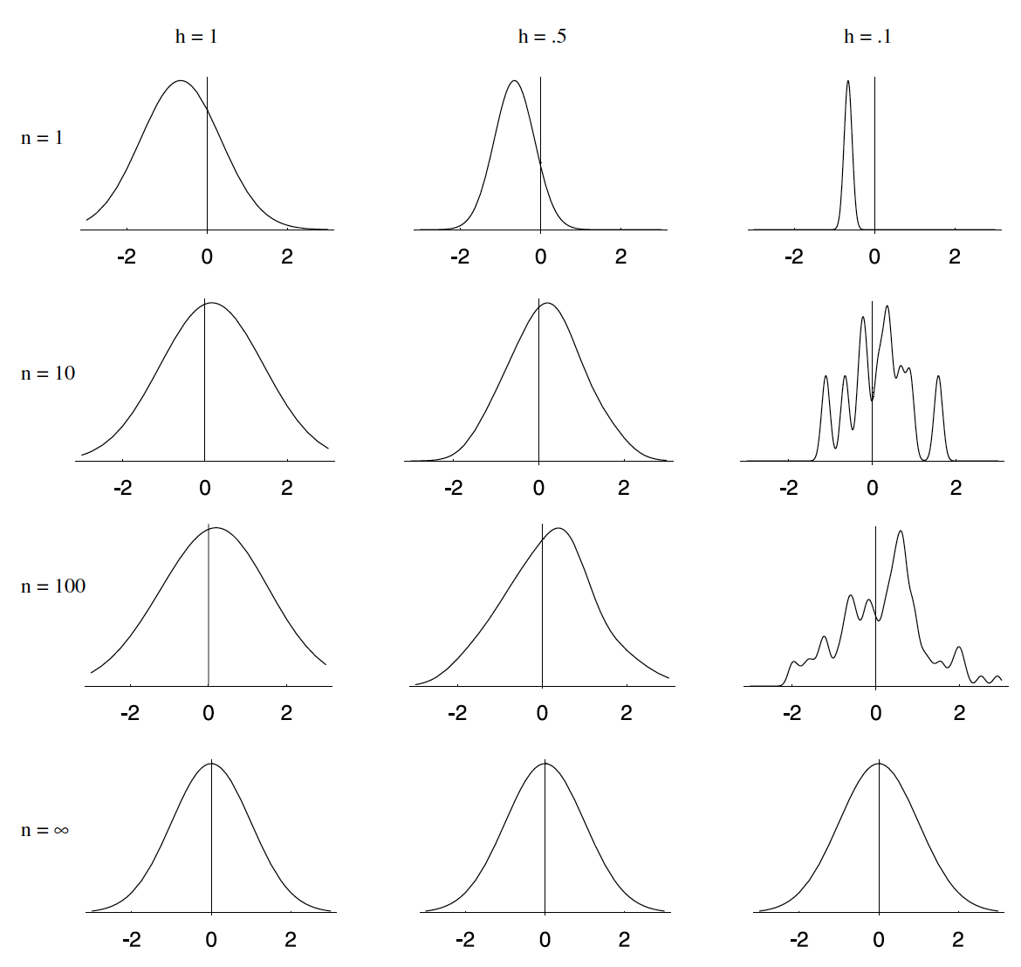
N(0, 1) Window to Estimate N(0, 1)
h₁=1
h₁=0.5
h₁=0.1
N=1
N=10
N=100
N=∞
Notes:
The three columns correspond to setting h1 to be 1, 0.5 and 0.1
And the four rows correspond to N = 1 samples, 10 samples, 100 samples and infinite samples.
We see that for infinite samples, we converge to the true distribution Gaussian with mean 0 and variance 1.
When there is only 1 sample, we essentially get our window function centered at the location. So it tells us more about our window function that the underlying distribution.
We see that for this particular example, setting h1 to be 1 seems to work decently well. When there are 10 samples, the estimate is already not bad.

Slide 50
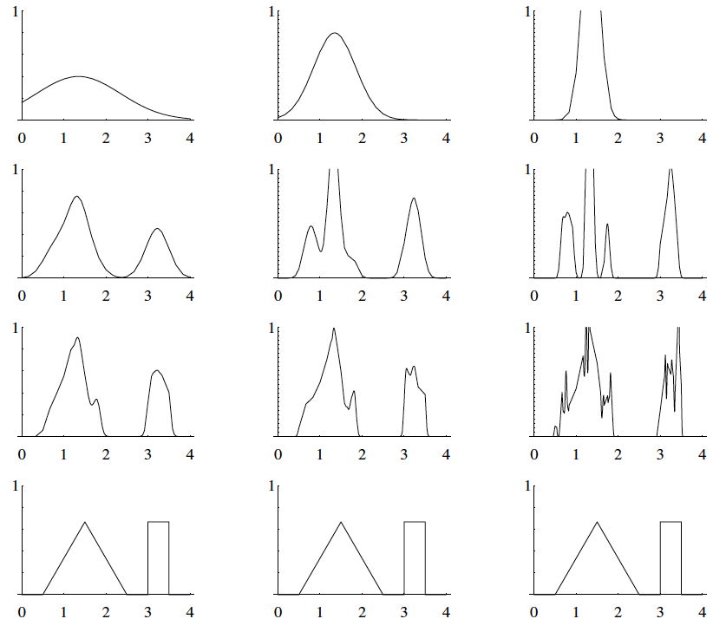
N(0, 1) Window to Estimate Bimodal Distribution
h₁=1
h₁=0.5
h₁=0.2
N=1
N=16
N=256
N=∞
Notes:
Here’s another example, where we still use Gaussian window of mean 0 and variance 1, but now we want to estimate the bimodal distribution.
With 256 samples, we see that h1 equal 1 and h1 equal 0.5 are decent?
But we probably need much more than 256 samples in order for the estimates to look like the true distribution.

Slide 51
Setting Window Size h
Notes:
In practice however, the number of sample points N is fixed and we need to set h.
So the previous convergence guarantees are not that helpful for us to set h.

Slide 52
Setting Window Size h
Notes:
What can do is to use cross validation.
So we can divide the training data into training and validation set.

Slide 53
Setting Window Size h
Notes:
For different window width h, we can compute the estimate p h of x based on the training samples.

Slide 54
Setting Window Size h
Notes:
We can then test our estimated distribution on the validation set by computing the log likelihood of the validation set.
This is equal to sum over i log of p h of x i, where x i corresponds to samples from the validation set.

Slide 55
Setting Window Size h
Notes:
And then we can pick the window width h that gives the highest log probability on the validation set.

Slide 56
Setting Window Size h
Notes:
Notice that all this is done on the training data. We never touch the test set.
Does this make sense?

Slide 57
Non-parametric Density Estimation: KNN
Notes:
We will now move on to KNN

Slide 58
K-Nearest Neighbors (KNN) Density Estimation
Notes:
Now let’s move on to K nearest neighbor.
This is the same formula as before, but now I have made the dependence on N explicit.
For K Nearest neighbors, rather than fix the window size, we grow the volume around x until we obtain k samples. Again we have made the depend on N explicit because we might want to modify the number of neighbors K depending on how many datapoints we have.

Slide 59
K-Nearest Neighbors (KNN) Density Estimation
Notes:
The nice property of KNN is that if the pdf is high at a location x, then the resulting window is going to be quite small in order to contain K neighbors.
If the pdf is small at location x, then the window is going to be quite big in order to contain K neighbors.
Therefore, the window size is adaptively adjusted so we have small windows and high resolution at high p of x. And big window but poor resolution at low p of x.

Slide 60
K-Nearest Neighbors (KNN) Density Estimation
Notes:
Again, there are convergence analysis that we can perform.
The K nearest neighbor estimate p N of x will converge to the true distribution p of x as the number of sample points goes to infinity IF AND ONLY IF
The number of neighbors k goes to infinity as N goes to infinity.
However, the number of neighbors divided by N has to be 0 as the number of sample points goes to infinity.
Therefore even though we want to increase the number of neighbors to infinity, the number of neighbors is small compared with the total number of samples.
The proof is not so hard but won’t be covered in this class. The proof is in the duda and hart textbook.

Slide 61
KNN Example
Notes:
Let’s see an example. Suppose we observe 6 samples: 2, 3, 4, 8, 10 and 11.
Suppose we want to use K nearest neighbors to estimate the probability distribution and for this example, we will use K equal to 3.

Slide 62
KNN Example
V = 8
Notes:
To estimate the pdf at x equal to 0, we grow our volume until we have 3 neighbors.
In this case, the volume is equal to 8, in order to capture 3 neighbors.
So p(x) is estimated to be K divided by N divided by V. K is equal to 3. N is equal to 6 and V is equal to 8.
And so we get 1 over 16.

Slide 63
KNN Example
V = 2
Notes:
How about the pdf at x equal to 3?
Here, the volume just needs to be 2 in order to capture 3 samples.
And so p(x) is estimated to be K divided by N divided by V. K is equal to 3. N is equal to 6 and V is equal to 2.
And so we get 1 over 4.

Slide 64
KNN Example
V = 3
Notes:
How about the pdf at x equal to 2.5?
Here, the volume has to be 3 in order to capture 3 samples.
And so p(x) is estimated to be K divided by N divided by V. K is equal to 3. N is equal to 6 and V is equal to 3.
And so we get 1 over 6.

Slide 65
KNN Example
V = 3
Notes:
How about the pdf at x equal to 3.5?
Here, the volume also has to be 3 in order to capture 3 samples.
And so p(x) is estimated to be K divided by N divided by V. K is equal to 3. N is equal to 6 and V is equal to 3.
And so we get 1 over 6.

Slide 66
KNN Example
Notes:
We can do this everywhere, and so we will get the following estimate of p of x.
We see that in general, p(x) is continuous but not differentiable.
And in fact, p of x might not even be a proper distribution. What I mean is that the area under the curve might actually not be equal to 1 and may even diverge to infinity.

Slide 67
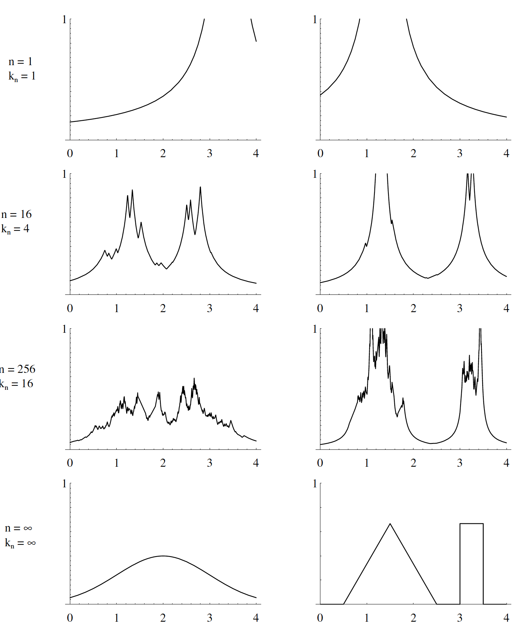
Estimating N(0, 1) and Bi-modal Distribution
N=1
N=16
N=256
N=∞
Notes:
Here’s an example, where on the LEFT we want to estimate the Gaussian distribution of mean 0 and variance 1, and on the RIGHT we want to estimate the Bimodal distribution like before.
We set the number of neighbors kN to be equal to k1 TIMES square root N, where k1 is set to 1. Therefore we have satisfied the conditions from the previous slide. As N goes to infinity, the number of neighbors K goes to infinity. However, kN divided by N is 1 over sqrt N, which goes to 0 as N goes to infinity.
Again we see that as N goes to infinity, we are guaranteed to converge to the true estimates.

Slide 68
Estimating N(0, 1) and Bi-modal Distribution
N=1
N=16
N=256
N=∞
Notes:
But for this particular settings, even with 256 samples, we don’t seem to get good estimates at least visually.

Slide 69
Estimating N(0, 1) and Bi-modal Distribution
N=1
N=16
N=256
Results do not look very impressive. For density estimation, most people use Parzen’s approach. But KNN used for classification instead (see later slides)
N=∞
Notes:
Indeed, for estimating probability distribution, most people use the Parzen’s window approach.
However, K nearest neighbors are very commonly used for classification instead.

Slide 70
Setting # Neighbors K
Notes:
Again, all the convergence analyses is nice, but in practice the number of samples is usually fixed and we need to set the number of neighbors K.
We can again use cross-validation to set K.
The procedure is exactly the same as Parzen Window except that instead of searching for the optimal window width h, we are searching for the optimal K.

Slide 71
Non-parametric Classification
Notes:
We will now use parzen window and K nearest neighbors for classification.

Slide 72
Classification
Notes:
Remember that given features x, we want to estimate class label y.

Slide 73
Classification
Notes:
In the previous slide, we estimate the likelihood p of x given y non-parametrically.
Now, we will estimate the entire joint density p of x and y non-parametrically.

Slide 74
Classification
Notes:
Suppose we want to estimate the class label for features x.
Let’s consider a volume V around x.
Let’s say this volume capture K samples. Of these K samples, k c samples were from class y equal to c.
Then, we can approximate the joint probability p of x and y = c to be k c DIVIDED by N divided by V.
So this is the fraction of samples in the window belonging to class c DIVIDED by V.

Slide 75
Classification
Notes:
Then, we can approximate the joint probability p of x and y = c to be k c DIVIDED by N divided by V.
So this is the fraction of samples in the window belonging to class c DIVIDED by V.

Slide 76
Classification
Notes:
The posterior probability p of y equal to class c conditioned on feature x is therefore equal to the joint distribution p of x and y equal to class c
DIVIDED by sum from c’ equal to 1 to capital C the joint probability distribution p of x and y equal to class c’.
This is just Bayes’ rule.

Slide 77
Classification
Notes:
We can plug in the formula from above.

Slide 78
Classification
Notes:
The N and V will cancel out from the number and denominator.
So the numerator becomes kc, while the denominator is sum over all kc’

Slide 79
Classification
Notes:
Sum over all kc’ is just capital K, so we have kc divided by K

Slide 80
Classification
Notes:
Therefore the posterior probability that feature x belongs to class c is simply the fraction of neighbors that are in class c.
Once we have the posterior probability, we will predict class c with highest posterior probability

Slide 81
Classification
Notes:
And we can use the Parzen’s window approach or the KNN approach.
And either case, the optimal volume V and optimal number of neighbors K can be determined by a cross-validation procedure that maximizes classification accuracy.
KNN classification is probably more common than Parzen’s window, and this is what you will code up in the programming assignment.

Slide 82
KNN Example
Suppose we have training set consisting of N images & each image is labeled as a human, cat or dog
Given a test image x, and suppose we set K = 5
Out of N training images, we find 5 images closest to the test image
Of these 5 images, let’s say 3 images are humans (i.e., k_{human} = 3), 1 image is a cat (i.e., k_{cat} = 1) and 1 image is a dog (i.e., k_{dog} = 1).
Then p(y = human | x) = k_{human}/K = 3/5
p(y = cat | x) = k_{cat}/K = 1/5
p(y = dog | x) = k_{dog}/K = 1/5
So the MAP estimate of x is human

Slide 83
KNN Computational Complexity & Metrics
Suppose features are D-dimensional => Compute distance between two samples require O(D) operations
Notes:
So let’s consider the computational complexity of KNN
For KNN classification, suppose our features are D-dimensional.
Then to compute the distance between two samples require roughly D operations.

Slide 84
KNN Computational Complexity & Metrics
Suppose features are D-dimensional => Compute distance between two samples require O(D) operations
For test sample, to find closest neighbor among N training samples, need to compute distance between test sample and each training sample => N x O(D) = O(ND) operations
Notes:
Given a new test sample, to find the closest neighbor among N training samples, we would need to compute distance between the test sample and each training sample.
So this would take roughly N times D operations,
So this can be quite slow.

Slide 85
KNN Computational Complexity & Metrics
Suppose features are D-dimensional => Compute distance between two samples require O(D) operations
For test sample, to find closest neighbor among N training samples, need to compute distance between test sample and each training sample => N x O(D) = O(ND) operations
To speed up:
Pruning/editing: for 1-NN, can remove data point surrounded by neighbors of the same class, resulting in subset of points (prototypes) used for classification
Notes:
Instead one trick that can be used is to prune the training samples.
At least in the case of 1 nearest neighbor classification, if a training sample is surrounded by neighbors of the same class, then we can simply remove the training sample without affecting the decision boundary.

Slide 86
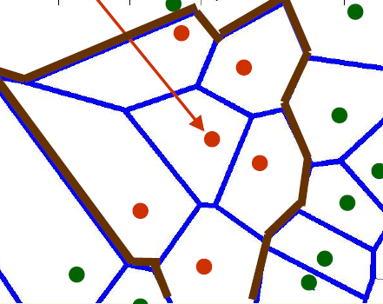
KNN Computational Complexity & Metrics
Suppose features are D-dimensional => Compute distance between two samples require O(D) operations
For test sample, to find closest neighbor among N training samples, need to compute distance between test sample and each training sample => N x O(D) = O(ND) operations
To speed up:
Pruning/editing: for 1-NN, can remove data point surrounded by neighbors of the same class, resulting in subset of points (prototypes) used for classification
Red dots: class 1
Green dots: class 2
Blue lines: equidistant between 2 or more dots
Brown lines: 1-NN decision boundary
Feature 2
Feature 1
Notes:
So in this example, red dots are from class 1 and green dots are from class 2.
The blue lines are equidistant between two or more dots.
The brown line is the decision boundary using 1 nearest neighbor.
In this example, notice that this red dot is surrounded by neighbors that are also red dot.

Slide 87
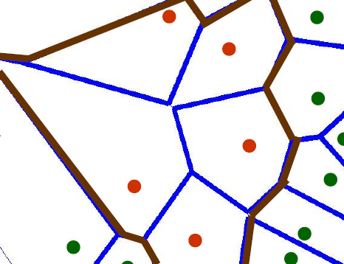
KNN Computational Complexity & Metrics
Suppose features are D-dimensional => Compute distance between two samples require O(D) operations
For test sample, to find closest neighbor among N training samples, need to compute distance between test sample and each training sample => N x O(D) = O(ND) operations
To speed up:
Pruning/editing: for 1-NN, can remove data point surrounded by neighbors of the same class, resulting in subset of points (prototypes) used for classification
Red dots: class 1
Green dots: class 2
Blue lines: equidistant between 2 or more dots
Brown lines: 1-NN decision boundary
Feature 2
Feature 1
Notes:
So if we remove this center red dot, the decision boundary shown by the brown line stays the same.
So this kind of preprocessing can greatly speed up the KNN classification.
However, this only works with 1 nearest neighbor

Slide 88
KNN Computational Complexity & Metrics
Suppose features are D-dimensional => Compute distance between two samples require O(D) operations
For test sample, to find closest neighbor among N training samples, need to compute distance between test sample and each training sample => N x O(D) = O(ND) operations
To speed up:
Pruning/editing: for 1-NN, can remove data point surrounded by neighbors of the same class, resulting in subset of points (prototypes) used for classification
Special data structure, e.g., https://en.wikipedia.org/wiki/K-d_tree
Notes:
Another thing that can be done is employ a special data structure which can speed up the nearest or K nearest look up for new data point.
So in both of these approaches, essentially we do some precomputing like removing some training samples or arrange the training samples into a data structure, so that for new data, we can perform the classification quickly.

Slide 89
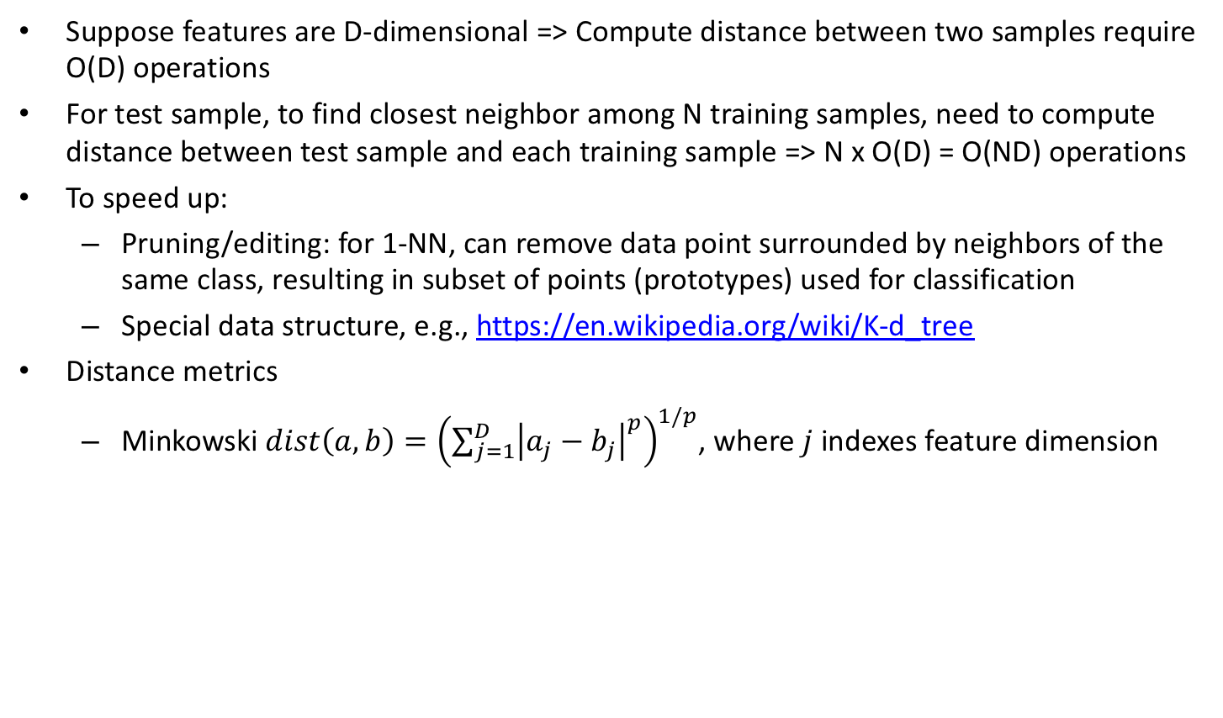
KNN Computational Complexity & Metrics
Suppose features are D-dimensional => Compute distance between two samples require O(D) operations
For test sample, to find closest neighbor among N training samples, need to compute distance between test sample and each training sample => N x O(D) = O(ND) operations
To speed up:
Pruning/editing: for 1-NN, can remove data point surrounded by neighbors of the same class, resulting in subset of points (prototypes) used for classification
Special data structure, e.g., https://en.wikipedia.org/wiki/K-d_tree
Distance metrics
Minkowski $dist\left(a, b\right)={\left(\sum_{j=1}^{D}{{\left|a_{j}−b_{j}\right|}^{p}}\right)}^{1/p}$, where$j$indexes feature dimension
Notes:
One important point in KNN classification and in machine learning, is how to define distance between data points.
Because the definition of distance can affect who the closest neighbors might be.
A general distance metric that is widely used is called the minkowski distance. The minkowski distance of vectors a and b is equal to sum from j = 1 to D absolute difference between aj and bj to the power of p and then we take whole thing and take it to the power of 1 over p.
So aj and bj indexes the j-th element of vectors a and b. So we can think of j as indexing the feature dimension.

Slide 90
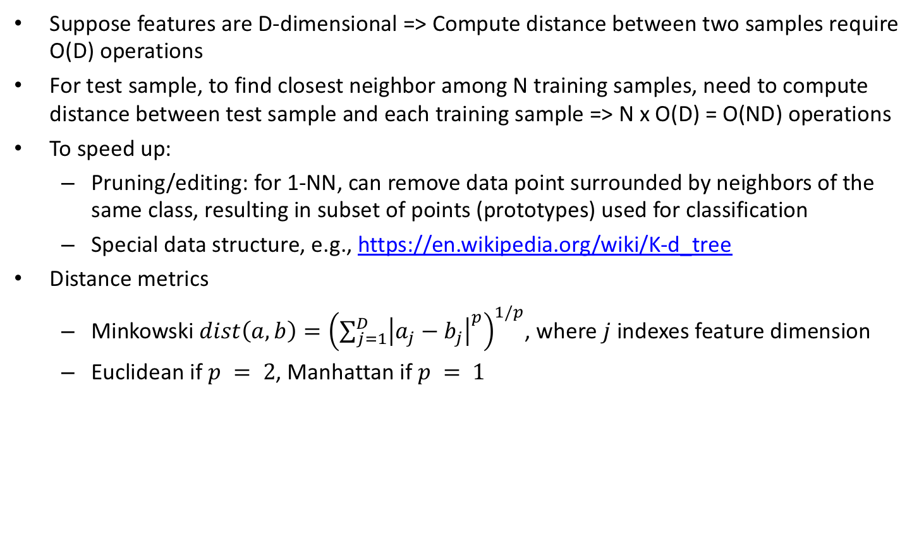
KNN Computational Complexity & Metrics
Suppose features are D-dimensional => Compute distance between two samples require O(D) operations
For test sample, to find closest neighbor among N training samples, need to compute distance between test sample and each training sample => N x O(D) = O(ND) operations
To speed up:
Pruning/editing: for 1-NN, can remove data point surrounded by neighbors of the same class, resulting in subset of points (prototypes) used for classification
Special data structure, e.g., https://en.wikipedia.org/wiki/K-d_tree
Distance metrics
Minkowski $dist\left(a, b\right)={\left(\sum_{j=1}^{D}{{\left|a_{j}−b_{j}\right|}^{p}}\right)}^{1/p}$, where$j$indexes feature dimension
Euclidean if $p = 2$, Manhattan if $p = 1$
Notes:
If p is equal to 2, then we get back the Euclidean distance.
If p is equal to 1, then we get the Manhattan or the taxi cab distance.
There are of course many many other distance metrics we can use.

Slide 91
Homework Assignment
You don’t need to use any special tricks like pruning or kd-tree
But if your code takes more than a few minutes, then your code is a bit inefficient, and you might want to speed things up
You won’t be graded on how fast your code run, but if your code runs very slow, it will be difficult for you to debug

Slide 92
Summary
Non-parametric approaches do not mean no parameters, but instead parameters grow with more data
Notes:
Today, we talk about non-parametric approaches.
Non-parametric does not mean no parameters, but instead the number of parameters grow with more data

Slide 93
Summary
Non-parametric approaches do not mean no parameters, but instead parameters grow with more data
Do not assume data is from specific distributions, such as Gaussian
Notes:
The nice thing about non-parametric approaches is that they do not assume the data is from a specific probability distributions, such as Gaussian.

Slide 94
Summary
Non-parametric approaches do not mean no parameters, but instead parameters grow with more data
Do not assume data is from specific distributions, such as Gaussian
Less assumptions imply non-parametric approaches need more data
Notes:
However, because they make less assumptions, it means that non-parametric approaches tend to need more data.

Slide 95
Summary
Non-parametric approaches do not mean no parameters, but instead parameters grow with more data
Do not assume data is from specific distributions, such as Gaussian
Less assumptions imply non-parametric approaches need more data
Two problems: density estimation and classification
Notes:
There are two problems we considered today. Density estimation and classification.

Slide 96
Summary
Non-parametric approaches do not mean no parameters, but instead parameters grow with more data
Do not assume data is from specific distributions, such as Gaussian
Less assumptions imply non-parametric approaches need more data
Two problems: density estimation and classification
Two approaches
Parzen’s window: Count number of neighbors inside fixed window size
Notes:
We consider two non-parametric algorithms.
In parzen’s window, we count the number of neighbors inside a window of fixed size.

Slide 97
Summary
Non-parametric approaches do not mean no parameters, but instead parameters grow with more data
Do not assume data is from specific distributions, such as Gaussian
Less assumptions imply non-parametric approaches need more data
Two problems: density estimation and classification
Two approaches
Parzen’s window: Count number of neighbors inside fixed window size
KNN: Expand window until K neighbors are captured
Notes:
In KNN, we expand the window until we capture K nearest neighbors.

Slide 98
Optional Reading
Notes based on
D&H Chapter 4.1-4.4, 4.5.5
Some figures taken from Dr. Tam and Dr. Sun

Slide 99
Additional Material

Slide 100
Convergence Proof of Parzen Window

Slide 101
Convergence of Mean

Slide 102
Convergence of Variance

